Slide 1
System Identification of Nonlinear State-Space Battery Models
ASMC 663 End-Of-Semester Presentation
Wei He
Department of Mechanical Engineering
weihe@calce.umd.edu
Course Advisor: Prof. Balan, Prof. Ide
Research Advisor: Dr. Chaochao Chen
Dec. 11 2012
Notes:
The title of this presentation is: Uncertainty Assessment of Prognostics Implementation of Electronics Under Vibration Loading.

Slide 2
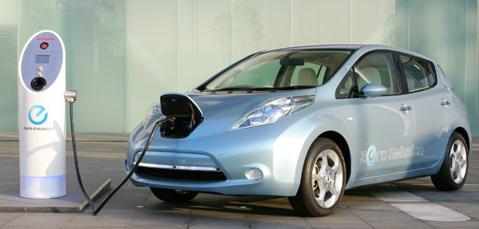
Background
Lithium-ion batteries are power sources for electric vehicles (EVs).
State of charge (SOC) estimation of batteries is important for the optimal energy control and residual range prediction of EVs.
SOC is the ratio between the remaining charge (Q_{remain}) and the maximum capacity of a battery (Q_{max})
Full: SOC = 100% Empty: SOC=0%

Slide 3
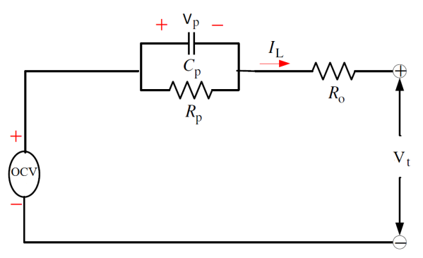
State-Space Representation of A Battery System
Process function [1-3] :
Measurement function:
Process and measurement noise
Problem Statement
The model parameters need to be identified

Slide 4
Problem Formulation
Estimate the unknown parameters in
based on the information in the measured input-output responses
using a maximum likelihood framework

Slide 5
Expectation Maximization (EM)
Expectation step (E step): calculate the expected value of the log likelihood function, with respect to the conditional distribution of X_{N} given Y_{N} under the current estimate of the parameters [4]
where X is the state variables: SOC and Vp.
Maximization step (M step): find the parameter that maximizes this quantity:
If not converged, update k->k+1 and return to step 2

Slide 6
Expectation Maximization (EM)
Ref[4] have proved that can be approximated by a particle smoother:

Slide 7
Particle Filter and Smoother
Particle smoother:
The particle smoother weights can be recursively calculated from particle filter weights
Particle filter:

Slide 8
Particle Filtering
Model prediction given past measurements
Process function

Slide 9
Particle Filtering
Prediction update using current measurement
posterior
Measurement
Equation
State Prediction

Slide 10
Particle Filtering [5]
represent state as a pdf
sample the state pdf as a set of particles and associated weights
propagate particle values according to model
update weights based on measurement
P(x)
x
t_{k}
t_{k+1}
t
actual state value
measured state value
state particle value
state pdf (belief)
actual state trajectory
estimated state trajectory
particle propagation
particle weight
x

Slide 11
Particle Filtering
Prediction step: use the state update model
Update step: with measurement, update the prior using Bayes’ rule:

Slide 12
Particle Filter Algorithm [4-7]
Initialize particles, and set t = 1.
Predict the particles by drawing M i.i.d samples according to
Compute the importance weights
For each j = 1,…,M draw a new particle with replacement (resample) according to
If t < N increment and return to step 2, otherwise terminate.

Slide 13
Particle Smoother Algorithm [4-7]
Run the particle filter and store the predicted particles and their weights , for t = 1,…,N.
Initialize the smoothed weights to be the terminal filtered weights at time t = N. and set t = N-1.
Compute the smoothed weights using the filtered weights and particles via
Update . If t > 0 return to step 3, otherwise terminate.

Slide 14
Simulated Data Sets
Parameter settings:
Process function:
Measurement function:
Process and measurement noise

Slide 15
Simulated Hidden States

Slide 16
Particle Filtering Result
Initial guess:
Particle number:50
RMS error = 0.0023

Slide 17
Particle Smoothing Result
RMS error = 0.0017

Slide 18
Project Schedule and Milestones
Project proposal: October 5 2012
Algorithm Implementation: - Particle filter and smoother: December 1 2012 - The full algorithm (particle EM): February 1 2012
Validation: March 15 2012
Testing: April 15 2012
Final Report: May 1 2012

Slide 19
References
H. He, R. Xiong, and H. Guo, Online estimation of model parameters and state-of-charge of LiFePO4 batteries in electric vehicles. Applied Energy, 2012. 89(1): p. 413-420.
C. Hu, B.D. Youn, and J. Chung, A Multiscale Framework with Extended Kalman Filter for Lithium-Ion Battery SOC and Capacity Estimation. Applied Energy, 2012. 92: p. 694-704.
H.W. He, R. Xiong, and J.X. Fan, Evaluation of Lithium-Ion Battery Equivalent Circuit Models for State of Charge Estimation by an Experimental Approach. Energies, 2011. 4(4): p. 582-598.
T.B. Schön, A. Wills, and B. Ninness, System identification of nonlinear state-space models. Automatica, 2011. 47(1): p. 39-49.
Bhaskar Saha, Introduction to Particle Filters, NASA.
M.S. Arulampalam, S. Maskell, N. Gordon, and T. Clapp, A tutorial on particle filters for online nonlinear/non-Gaussian Bayesian tracking. Signal Processing, IEEE Transactions on, 2002. 50(2): p. 174-188.
A. Doucet and A.M. Johansen, A tutorial on particle filtering and smoothing: fifteen years later. Handbook of Nonlinear Filtering, 2009: p. 656-704.

