Slide 1
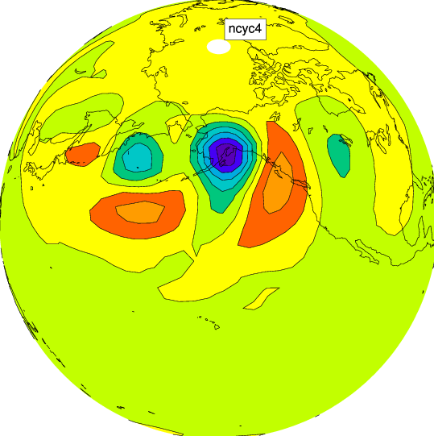
Reduction of Temporal Discretization Error in an Atmospheric General Circulation Model (AGCM)
Daisuke Hotta
hotta@umd.edu
Advisor: Prof. Eugenia Kalnay
Dept. of Atmospheric and Oceanic Science,
University of Maryland, College Park
ekalnay@atmos.umd.edu

Slide 2
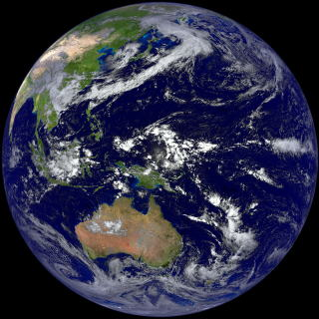
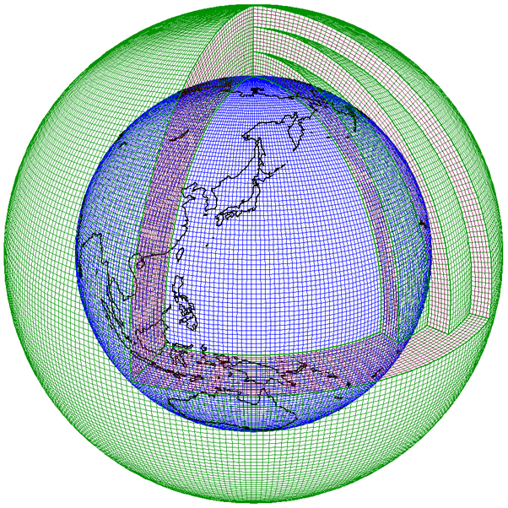
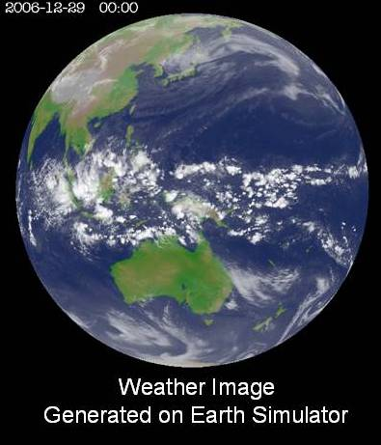
Numerical Weather Prediction (NWP):
= Initial Value Problem of PDE
Atmospheric Phenomena
Governing Equations
Numerical
Discretization
Solve !
(Simulate)
from http://www.jma.go.jp/jma/jma-eng/jma-center/nwp/nwp-top.htm
(Real Atmosphere)
(from JMA website)
Simulated Atmosphere
from http://iprc.soest.hawaii.edu/news/news_2009.php
Hydrodynamic PDE
O(10⁹)-dimensional ODE
AGCM: Atmospheric General Circulation Model
= a computer program which simulates the flow of global atmosphere by numerically integrating the governing fluid dynamical PDEs

Slide 3
Introduction: Motivation
Due to computational restrictions …
most AGCMs adopt low-order time-integration schemes, such as
Leap-frog with Robert-Asselin filter (1st order)
Explicit Backward Euler (aka. Matsuno; 1st order)
Often, Δt is taken as the largest value for which computational instability is suppressed,
under the premise that temporal discretization errors are negligible compared to those associated with spatial discretization or Physical Parameterizations.

Slide 4
Introduction: Motivation
However …
Spatial resolutions become finer and finer as the supercomputers become faster.
Is the premise that time truncation errors are negligible justified ?
If not, how can we alleviate such errors ?
→ Goal of the Project: Reduction of such model errors
Approaches :
Phase 1: Use a more accurate scheme with the same
computational cost
Phase 2: Identify and parameterize the error, and reduce
it using data assimilation
Notes:
Made changes

Slide 5
Phase 1 : A Better integration scheme (Lorenz N-cycle)
Lorenz (1971) proposed an incredibly smart time-integration scheme which:
requires only 1 function evaluation per step
but yet (every N steps) it is of
- (up to) 4th-order accuracy (for nonlinear systems)
- arbitrary order of accuracy (for linear systems)
However, this scheme seems to have remained forgotten.
No applications have been made to AGCMs.
➔ Apply Lorenz N-cycle to an AGCM (Phase 1)

Slide 6
Phase 1: Approach
Implement Lorenz N-cycle to an existing AGCM
Implement 4th order Runge-Kutta (RK4) as well as a reference
Compare the accuracy and efficiency of the newly introduced schemes with the original scheme
Perform verification by the Jablonowski-Williamson (2006) Dynamical-core Tests

Slide 7
Phase 1: Algorithms
ODE to be solved:
(existing) Leap-frog with
Robert-Asselin Filter
Lorenz N-cycle
4th order Runge-Kutta
Memory consumption:
2 x dim{model state}
Memory consumption:
2 x dim{model state}
Memory consumption:
5 x dim{model state}
F-evaluation: 1 per time step
F-evaluation: 1 per time step
F-evaluation: 4 per time step
accuracy: (N <= 4)
O((NΔt)^{N}) (every N steps)
O(NΔt ) (in between)
accuracy:
O(Δt )
accuracy:
O(Δt⁴ )

Slide 8
AGCM: SPEEDY model
A fast AGCM with simplified physical parameterizations
Developed in ICTP (Italy) by Drs. F. Molteni and F. Kucharski
Horizontal Discretization:
Spectral Representation with Spherical Harmonics
truncated at total wavenumber 30 (T30) ≈ 400km mesh
Vertical Discretization:
8-layers Finite Difference on σ-coordinate
Temporal Discretization:
Leap-Frog scheme with Robert-Asselin Filter
(1st order Forward Euler for the physical parameterizations)
Notes:
changes

Slide 9














The equations solved: the “primitive” equation system (PDEs) on a spherical geometry + parametrized processes
Dynamical Core
Sub-grid Parametrizations
…..

Slide 10
AGCM: SPEEDY model
Language: Fortran77
Platform: Any machine which supports Fortan77 compiler (a Linux server will be used in this study)
Code statistics: ∼10,000 lines, 73 files
# predicted variables: ∼ Ο(10⁵)
Implementation to be made:
Add new subroutines for N-cycle and RK4 schemes
(for validation)
Add an Option to Switch-off Physical Parameterizations
Add an Option to run with flat orography

Slide 11
Achievements of the semester
Implementation of Lorenz N-cycle and RK4 schemes to SPEEDY
Code Validations
Options for the Dynamical-Core tests (=Verification)
Results of the Dynamical-Core tests (=Verification)
Several Formulations of Semi-implicit scheme and their stability analysis tested with toy models
Notes:
changes

Slide 12
Code Validation: Idea
Lorenz N-cycle:
  Lorenz 1-cycle is equivalent to Forward Euler, which is built-in in the SPEEDY model.
  → Compare Lorenz 1-cycle with Forward Euler.
RK4 :
  For a linear system, RK4 with 4Δt is equivalent to Lorenz 4-cycle with Δt.
  → Remove all nonlinear terms from SPEEDY and Compare RK4 (4Δt) with Lorenz 4-cycle (Δt).

Slide 13
Code Validation: Results
Outputs of single step integrations of Lorenz 1-cycle and Forward Euler from the same initial condition are compared using UNIX diff command.
  Result → no difference (Success)!
Similarly, outputs of single step integration of RK4 and four-step integration of Lorenz 4-cycle from the same initial condition are compared using UNIX diff command.
  Result → no difference (Success)!

Slide 14
Verification: Dynamical-Core test cases
Standardized tests for dynamical cores of AGCM proposed by Jablonowski and Williamson (2006) which consists of two tests:
Steady-State test:
  A model is integrated from an analytical steady-state solution of the primitive equation
  The model evaluated by how well it can keep the steady-state intact.
Baroclinic-Wave test:
  The model is integrated with initial and boundary conditions which is designed to produce an idealized baroclinic wave (= extratropic cyclones and highs)

Slide 15
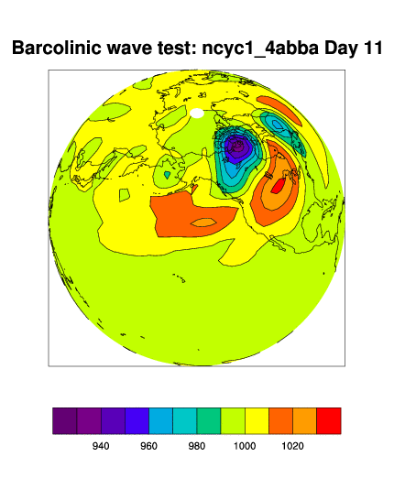
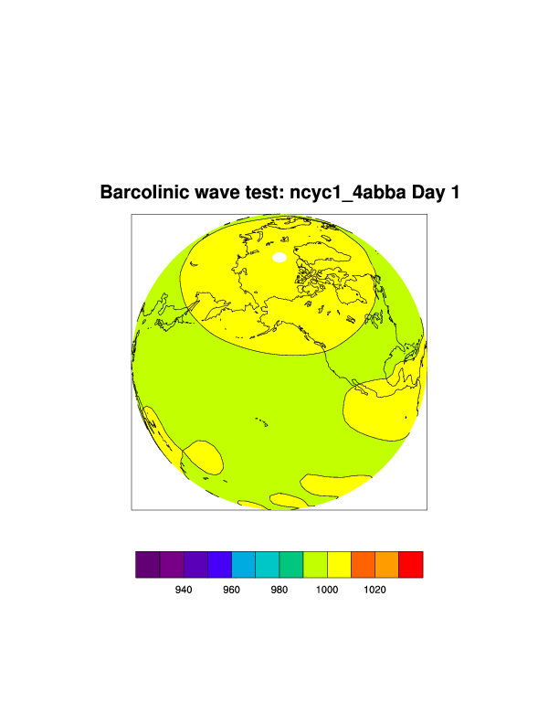
Baroclinic-wave Test: Result (Lorenz 4-cycle)

Slide 16
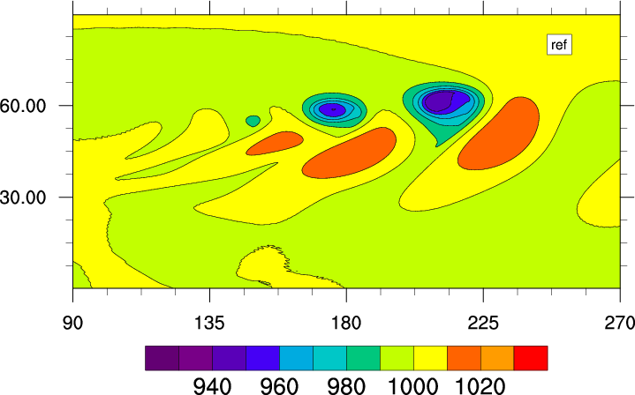
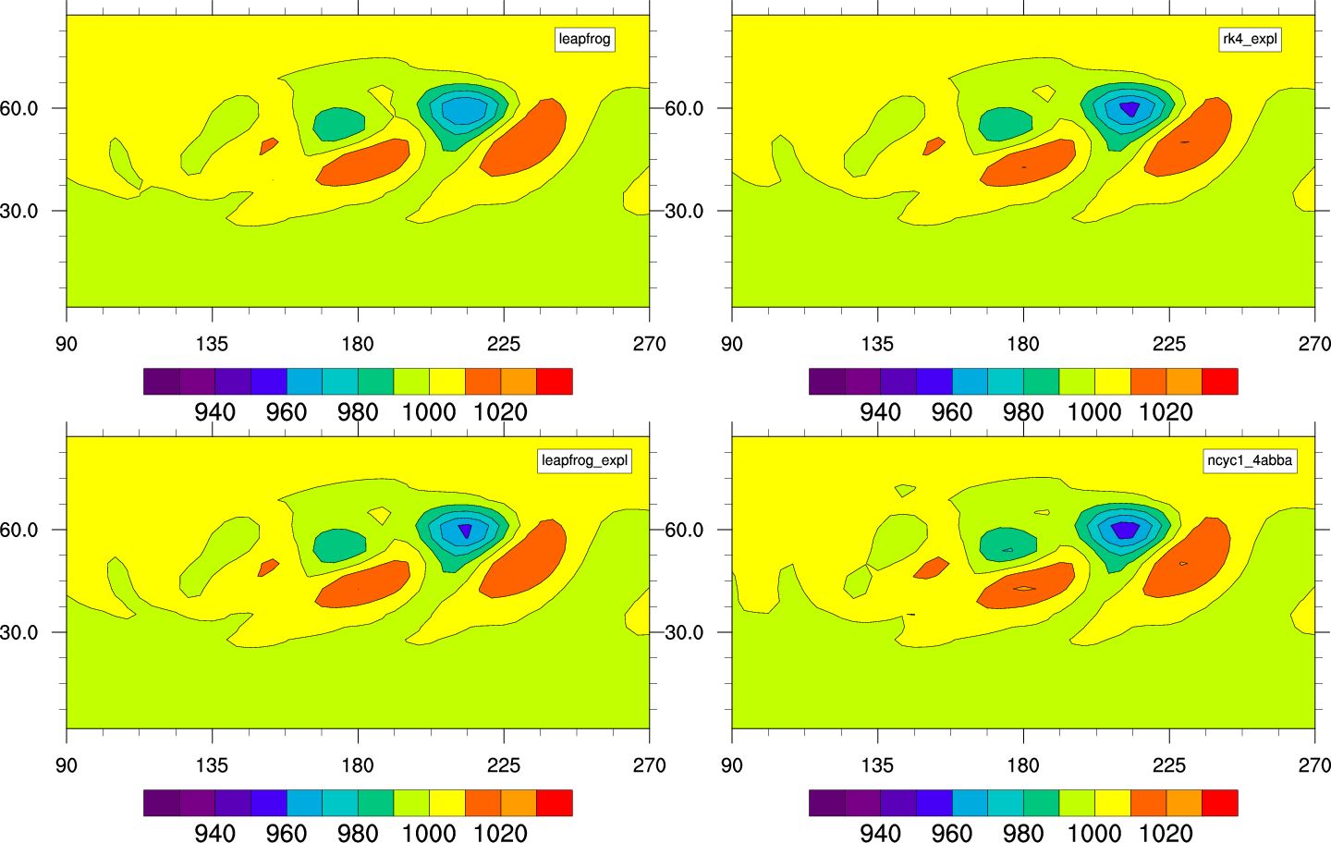
Snapshots of surface-pressure at Day 9
Hi-res. reference solution
Leapfrog (dt=20min)
RK4 (dt=1min)
Leapfrog (dt=1min)
N-cycle (dt=20min)

Slide 17
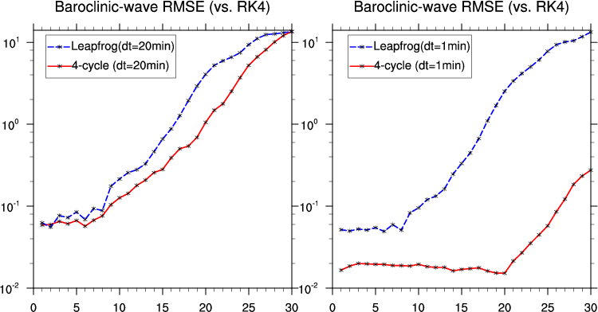
Quantitative Comparison:
RMSE of surface pressure (vs. RK4)
Time(Days)
Time(Days)

Slide 18
Deliverables (Phase 1)
Upgraded code for SPEEDY model
  subroutines for Lorenz N-cycle
  4th order Runge-Kutta
Test-case results for the SPEEDY model (both for the original scheme and the new schemes)
✔
✔
✔

Slide 19
Schedule and Milestones
Phase 1:
Phase 2:
Implement RK4 and N-cycle, Nov.
Write the mid-year report, prepare the oral presentation, Dec.
Switch-off physical parameterizations, prepare flat topography, Jan.
perform the dynamical core tests. Feb.
Generate initial values from the NCEP/NCAR reanalysis, end of Feb.
build the bias and covariance matrix, Mar.
Code and test a program for SVD, Apr.
Compare the model errors for the new and the original shcemes, May.
Write the final report (paper draft), May.
✔
✔
✔
✔
Notes:
change

Slide 20
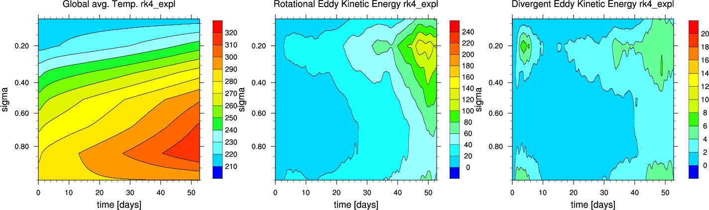
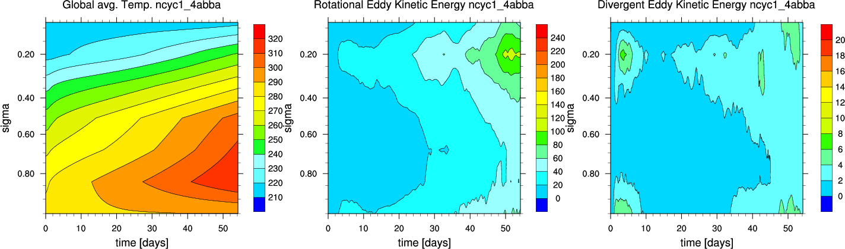
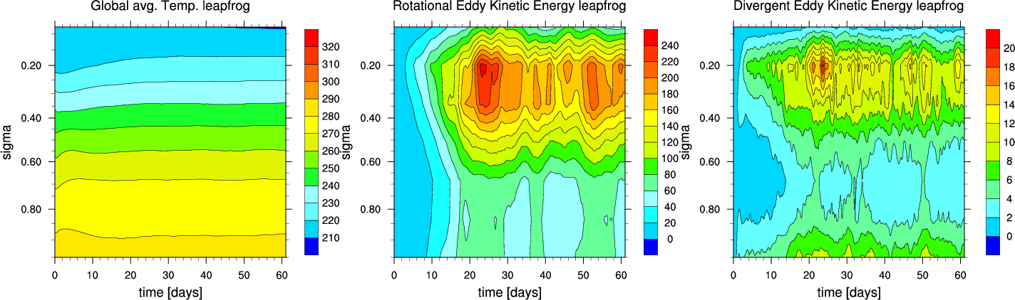
Unexpected Problem:
N-cycle, RK4 and Euler-forward blow up when physical parameterizations are on
Temperature
Vorticity
Divergence
RK4
N-cycle
Leapfrog
Notes:
Changed title

Slide 21
(Possible) Modification to the Plan
The original plan for the Phase 2 is to identify and correct model errors of N-cycle SPEEDY with physics, using NCEP/NCAR reanalysis as truth
which is impossible if N-cycle with physics blows up.
Plan:
  Continue working on the issue with physics for one more month.
  If the issue is fixed, then continue Phase 2 as planned.
  If not, modify the Phase 2:
    Use RK4 without physics as Truth.
    Try to identify and correct model errors of N-cycle without physics.

Slide 22
Summary
Implemented and tested Lorenz N-cycle and RK4 for the SPEEDY AGCM
Code validation was successful
Verification with the Dynamical Core test confirmed that Lorenz N-cycle is much more accurate than the conventional Leapfrog.
However, SPEEDY with full physics blows up if the temporal discretization is Lorenz N-cycle, RK4 or forward Euler (i.e. anything other than leapfrog).
Modification to the Phase 2 may be in order.

Slide 23
Bibliography
Lorenz N-cycle
Lorenz, Edward N., 1971: An N-cycle time-differencing scheme for stepwise numerical integration. Mon. Wea. Rev., 99, 644–648.
SPEEDY model
Molteni, Franco, 2003: Atmospheric simulations using a GCM with simplified
physical parameterizations. I. Model climatology and variability in
multi-decadal experiments. Clim. Dyn., 20, 175-191.
Kucharski F, Molteni F, and Bracco A, 2006: Decadal interactions between the western tropical Pacific and the North Atlantic Oscillation. Clim. Dyn., 26, 79-91
SPEEDY-LETKF
Miyoshi, T., 2005: Ensemble Kalman filter experiments with a primitive-equation global model. Ph.D. dissertation, University of Maryland, College Park, 197pp.
Atmospheric GCM Dynamical Core test cases
Jablonowski, C. and D. L. Williamson 2006: A baroclinic instability test case for atmospheric model dynamical cores, Q. J. R. Metorol. Soc., 132, 2943-2975
NCEP/NCAR reanalysis
Kalnay, E., and Coauthors, 1996: The NCEP/NCAR 40-Year Reanalysis Project. Bull. Amer. Meteor. Soc., 77, 437–471.
Model Error Correction
Danforth, Christopher M., Eugenia Kalnay, Takemasa Miyoshi, 2007: Estimating and Correcting Global Weather Model Error. Mon. Wea. Rev., 135, 281–299.
Danforth, Christopher M., Eugenia Kalnay, 2008: Using Singular Value Decomposition to Parameterize State-Dependent Model Errors. J. Atmos. Sci., 65, 1467–1478.

Slide 24
back-up slides

Slide 25
Lorenz N-cycle with semi-implicit integration

Slide 26
Motivation
For a practical AGCM, semi-implicit treatment of fast inertia-gravity wave is indispensable to allow for a large time stepping.
Semi-implicit treatment “unlocks” CFL constraint associated with the fast waves.
However, for some schemes (including Forward Euler or 3rd-order Adans-Bashforth), semi-implicit treatment does not help stabilize integration
➔ Examine the stability for Lorenz N-cycle

Slide 27
Method
Following Durran (1991, 1999; MWR) and Williamson (2011; MWR), apply semi-implicit modification to the second term of the equation:
Examine the modulus of Amplification factor A.
If |A| < 1, the scheme is stable.
Range of interest:
i.e., CFL condition is met for low-frequency part but is violated for high-frequency part.

Slide 28
Approach 1:
Semi-implicit correction on every time step
Algorithm
Truncation Error:
By choosing β=1/2 (Crank-Nicolson), the scheme becomes second-order

Slide 29
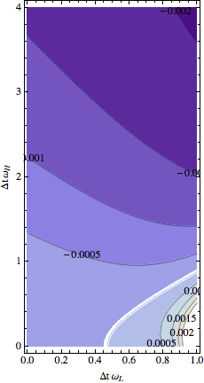
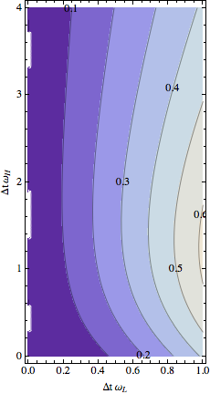
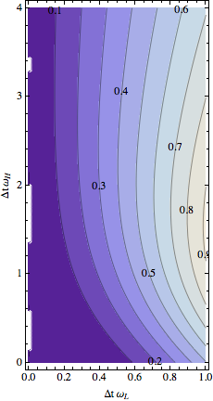
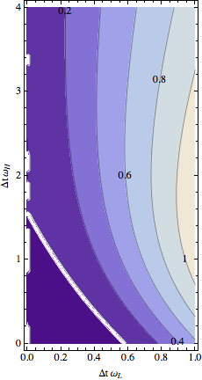
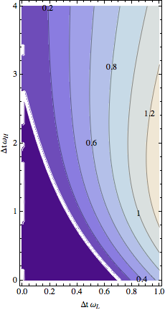
Plots of |A|-1 (β=1/2: Crank-Nicolson)
Unstable
Stable
Unstable
Unstable
Unstable
Unstable
Stable
Stable
Leapfrog with R/A filter:
Stable almost everywhere
Lorenz 1-cycle (=Forward Euler):
Unstable everywhere
Lorenz 2-cycle:
Unstable everywhere
Lorenz 3-cycle:
Absolutely Unstable for
> 1.5
Lorenz 4-cycle:
Absolutely Unstable for
> 2.7

Slide 30
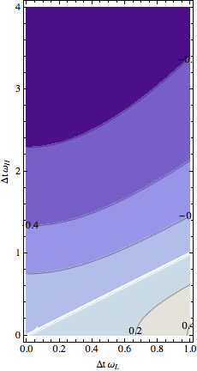
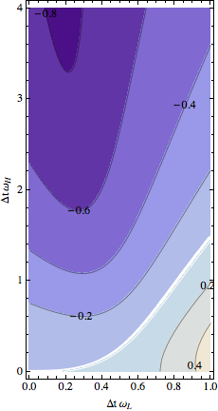
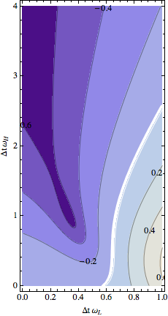
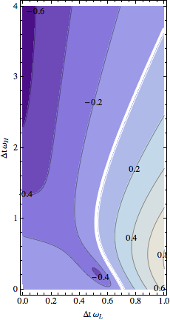
Plots of |A|-1 (β=1: Backward Euler)
Stable
Stable
Stable
Stable
Stable
Unstable
Unstable
Unstable
Unstable
Unstable
Ref:
Leapfrog+R/A filter
Lorenz 1-cycle (=Forward Euler):
Lorenz 2-cycle:
Lorenz 3-cycle:
Lorenz 4-cycle:
Stability is good, but damping is too strong (∼50%)

Slide 31
Approach 2:
Semi-implicit correction on every N time steps
Algorithm
Truncation Error:
The scheme is only 1st order, even for β=1/2 (Crank-Nicolson)
Stability is also horrible (not shown)

Slide 32
After trial and errors, I found that the following algorithm:
gives the truncation error
which, for β=1/2, makes the scheme 2nd order.

Slide 33
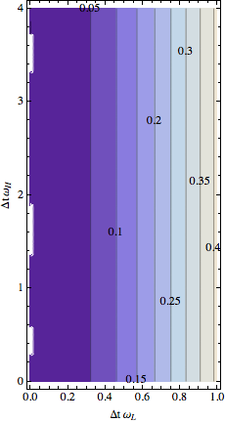
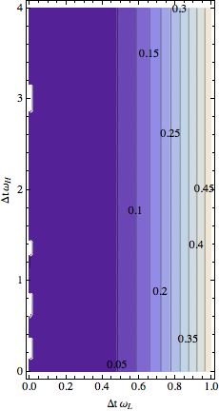
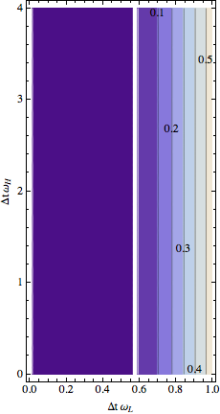
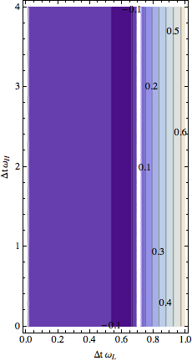
Plots of |A|-1 (β=1/2: Crank-Nicolson)
Unstable
Stable
Unstable
Stable
Unstable
Stable
Unstable
Unstable
Reference: Leapfrog wirh R/A filter
Lorenz 1-cycle (=Forward Euler):
Unstable everywhere
Lorenz 2-cycle:
Unstable everywhere
Lorenz 3-cycle:
Stable for
< 0.5
Lorenz 4-cycle:
Stable for
< 0.7

Slide 34
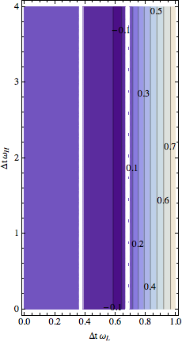
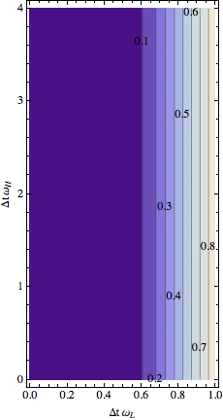
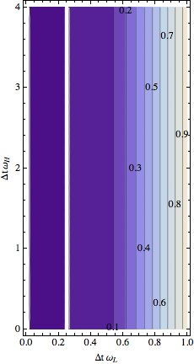
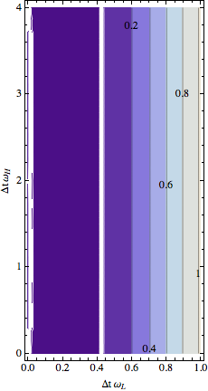
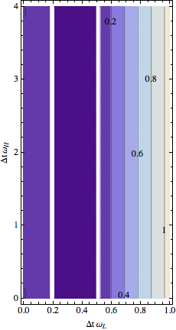
Stability for larger N
Unstable
Stable
Unstable
Stable
Unstable
Stable
Unstable
Unstable
Unstable
5-cycle:
stable only in the band
0.4< < 0.7
6-cycle:
everywhere
unstable
7-cycle:
stable only for
< 0.21
8-cycle:
stable only for
< 0.4
9-cycle:
stable only in the band
0.2< < 0.5

Slide 35
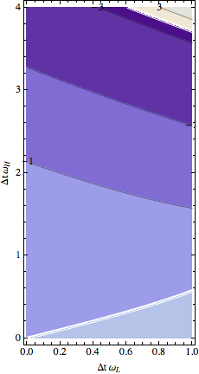
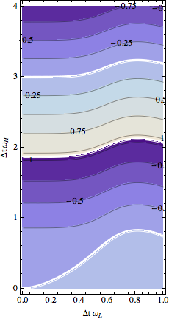
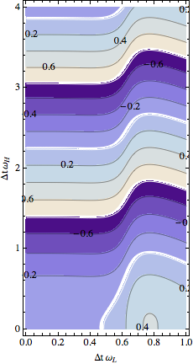
Phase error (β=1/2: Crank-Nicolson)
Reference: Leapfrog wirh R/A filter
Lorenz 3-cycle
Lorenz 4-cycle

Slide 36
Swinging-pendulum problem
A simple nonlinear test-bed for semi-implicit schemes.
Fast oscillation = elastic spring
Slow oscillation = pendulum
Fast mode is treated implicitly, slow mode explicitly.
For this test, I use Δt=0.075 which gives
ω_{LOW}Δt=0.225, ω_{HIGH}Δt=2.25,
From Williams (2011)

Slide 37
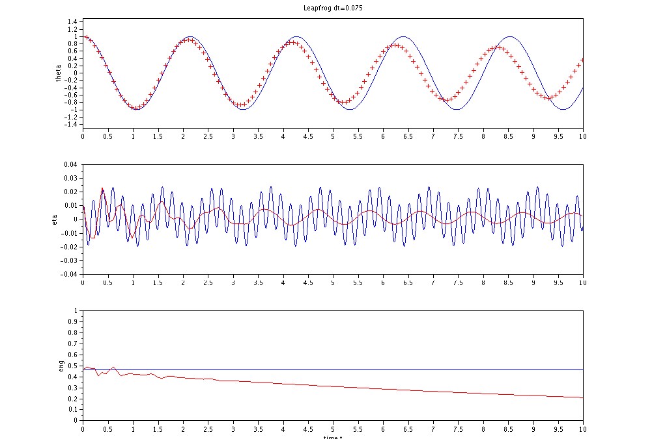
Leapfrog with RA filter (α=0.01)
RK4 with Δt=10⁻⁶
θ
+
Leapfrog
η
Energy

Slide 38
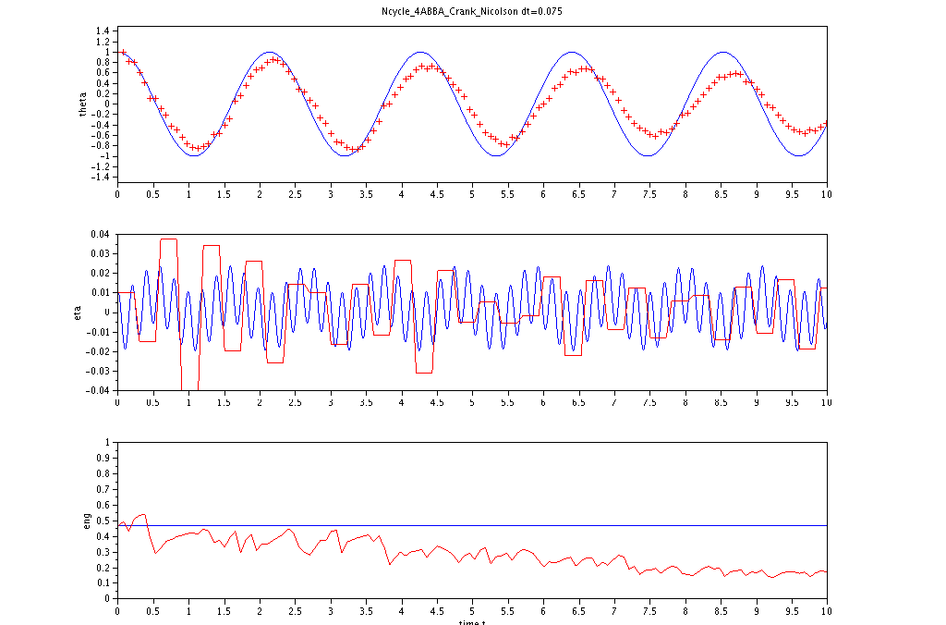
4-cycle with semi-implicit correction on every 4 steps (Crank-Nicolson)
RK4 with Δt=10⁻⁶
θ
+
Leapfrog
η
Energy

Slide 39
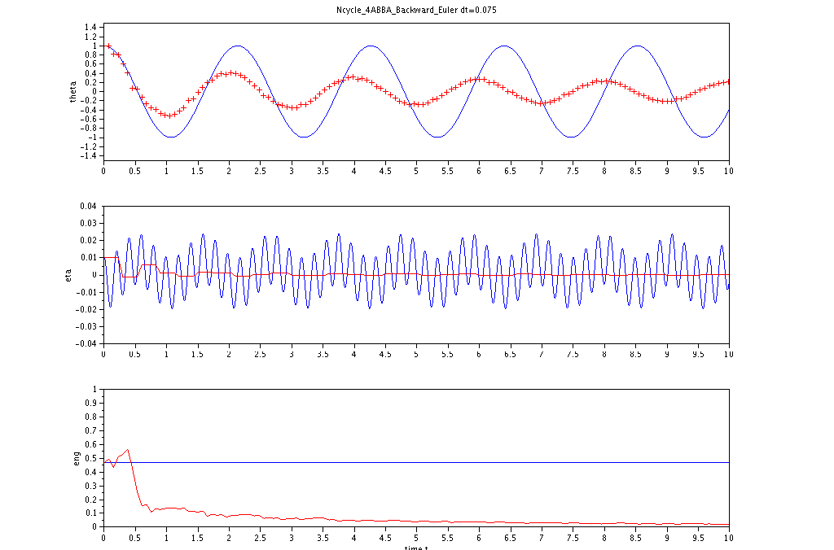
4-cycle with semi-implicit correction on every 4 steps (Backward)
➔ stable but very dissipative
RK4 with Δt=10⁻⁶
θ
+
Leapfrog
η
Energy

Slide 40
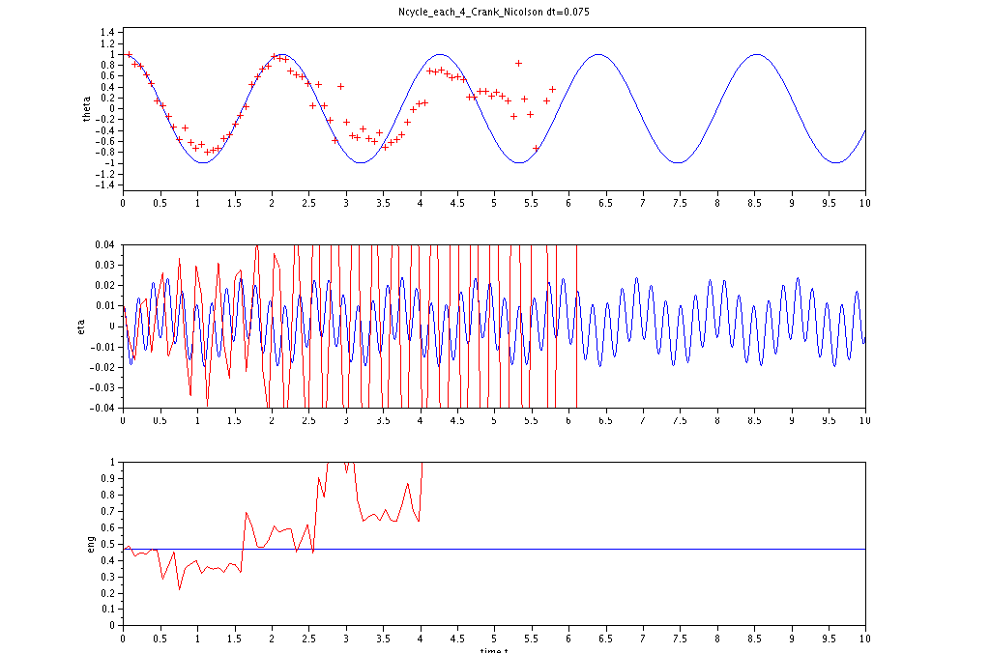
4-cycle with semi-implicit correction on every time step ➔ unstable
RK4 with Δt=10⁻⁶
θ
+
Leapfrog
η
Energy

Slide 41
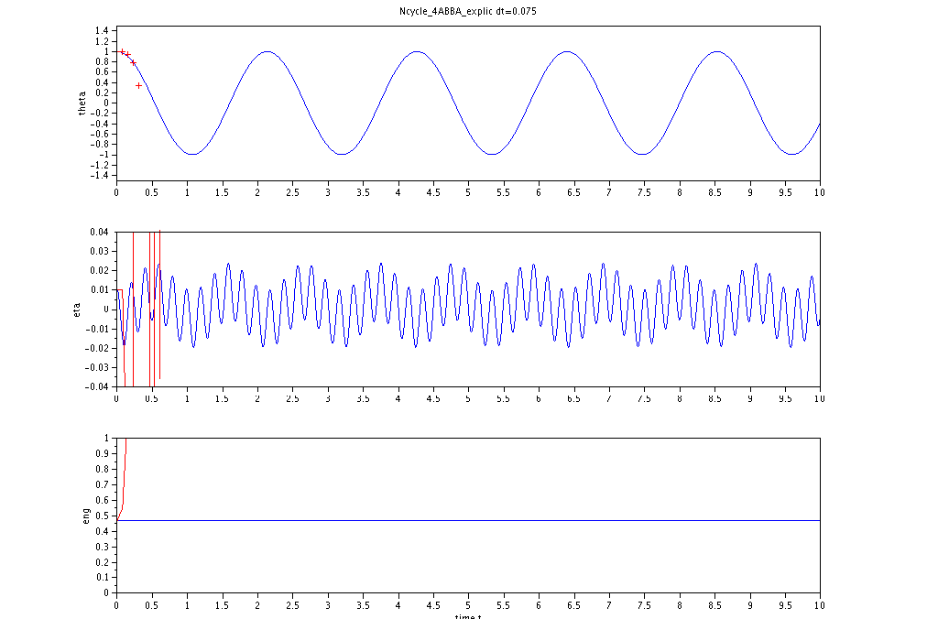
Explicit 4-cycle
➔ unstable
RK4 with Δt=10⁻⁶
θ
+
Leapfrog
η
Energy

Slide 42
Summary
Consistent with the linear analysis,
N-cycle with semi-implicit on each time step
  ➔ unstable
N-cycle with semi-implicit on every N steps
  Crank-Nicolson: stable, but comparable accuracy with Leapfrog
  Backward Euler: stable, very dissipative

Slide 43
Reference:
Williams, P. D. 2011: The RAW Filter: An Improvement to the Robert–Asselin Filter in Semi-Implicit Integrations, Mon. Weath. Rev., 139, 1996--2007

Slide 44
Runge-Kutta 4th-order scheme with semi-implicit correction

Slide 45
Introduction
I implemented semi-implicit Runge-Kutta 4th-order scheme to SPEEDY model and found that
  for Crank-Nicolson, the model blows up, even for very small dt (1min).
  for Backward Euler, the model is too diffusive that the baroclinic-wave dynamical core test fails to produce the baroclinic wave.
Explicit Runge-Kutta 4th-order scheme with small dt (5min) works fine for the dynamical core test.
→ examine stability using the toy-model

Slide 46
Method
Following Durran (1991, 1999; MWR) and Williamson (2011; MWR), apply semi-implicit modification to the second term of the equation:
Examine the modulus of Amplification factor A.
If |A| < 1, the scheme is stable.
Range of interest:
i.e., CFL condition is met for low-frequency part but is violated for high-frequency part.

Slide 47
Algorithm:
RK4 for ω_{L} , Crank-Nicolson for ω_{H}
Truncation Error:
the accuracy is only 1st order

Slide 48
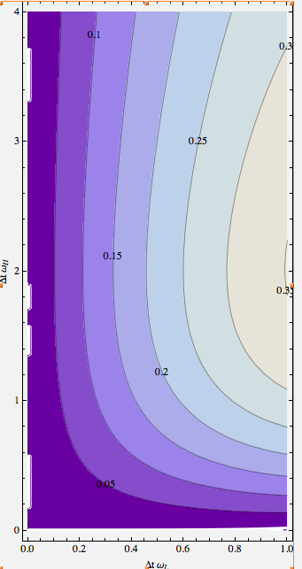
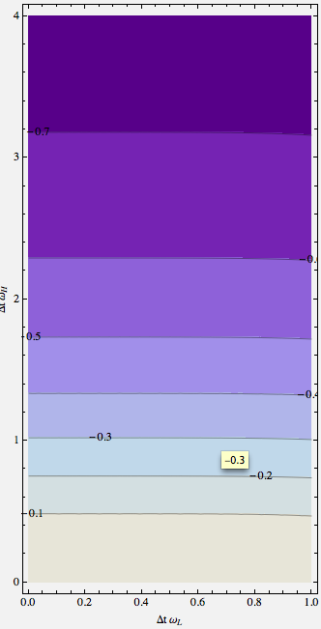
Plot of |A|-1
β=1/2: Crank-Nicolson
-> Absolutely unstable
β=1: backward Euler
-> Absolutely stable,but extremely dissipative

Slide 49
Summary
Runge-Kutta 4th-order scheme with semi-implicit time is
  only of first order (with respect to fast modes)
  absolutely unstable if Crank-Nicolson is used
  absolutely stable if Backward Euler is used, but the numerical damping is too strong (more than halving on every time step)
all of the above are consistent with what I found for the SPEEDY model.

Slide 50
Conclusion
Runge-Kutta 4th-order scheme with semi-implicit time-stepping for gravity waves is impossible (either unstable or too dissipative)
The accuracy becomes only of 1st order.
Since the motivation for implementing Runge-Kutta 4th-order scheme is to produce a reference solution, I will not try to resolve this issue, and use the explicit scheme with small dt.

Slide 51
Stability analysis of Forward Euler “split physics” for Leapfrog, Lorenz 4-cycle and RK4

Slide 52
Toy model: linear advection-diffusion equation
Undiscretized equation:
The first term of the RHS simulates the dynamics of AGCM, and the second the physics.

Slide 53
Discretization: Leapfrog(dyn) + Euler(phys)
Discretized equation:
The amplification factor A satisfies the following equation:
(+) and (-) correspond, respectively, to physical and computational modes.
The scheme is stable if the maximum of the moduli of them is less than 1.

Slide 54
Discretization: Leapfrog for both dyn & phys
Discretized equation:
The amplification factor A satisfies the following equation:
(+) and (-) correspond, respectively, to physical and computational modes.
The scheme is stable if the maximum of the moduli of them is less than 1.

Slide 55
Discretization: Lorenz 4-cycle (dyn) + Euler(phys)
Discretized equation:
Amplification factor (per time step):

Slide 56
Discretization: Lorenz 4-cycle for both dyn & phys
Discretized equation:
Amplification factor (per time step):

Slide 57
Discretization: RK4(dyn) + Euler(phys)
Discretized equation:
Amplification factor :

Slide 58
Discretization: RK4 for both dyn&phys
Discretized equation:
Amplification factor (per time step):

Slide 59
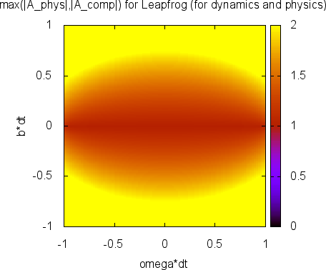
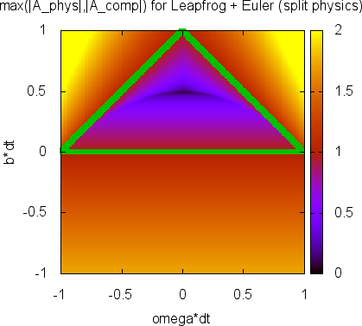
Leapfrog:
“split physics” stabilizes the otherwise absolutely unstable scheme
Leapfrog for both dyn & phys: absolutely unstable
Leapfrog (dyn) + Euler (phys): Stable within the triangle
stable
unstable
unstable

Slide 60
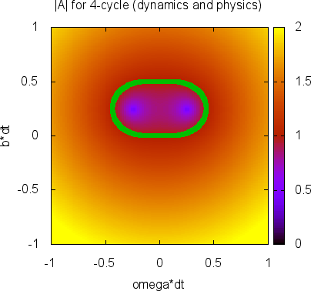
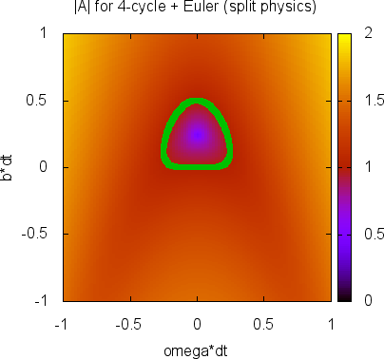
Lorenz 4-cyle:
“split physics” destabilizes the scheme
Lorenz 4-cycle for dyn & phys: absolutely unstable
L4-cycle (dyn) + Euler (phys): Stable within the triangle
stable
stable
unstable
unstable

Slide 61
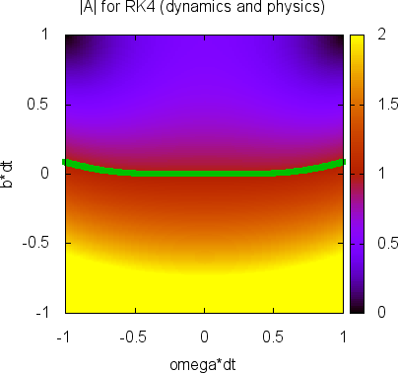
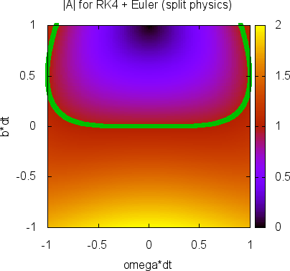
RK4: again, “split physics” destabilizes the scheme
RK4 for dyn & phys: absolutely unstable
RK4 (dyn) + Euler (phys): Stable within the triangle
stable
stable
unstable
unstable

Slide 62
Summary
For leapfrog, doing “split physics” works very well (stabilizes the scheme)
However, for Lorenz 4-cycle (and equivalently, for RK4), “split physics” acts to destabilized the scheme.
The latter is consistent with what I found by doing “split physics” with SPEEDY model.

Slide 63
Next to do
I found that “symmetric splitting” semi-implicit scheme significantly stabilizes Lorenz N-cycle.
Analogously, there is a hope that doing “symmetric splitting” for physics may help stabilized the model.
→ Examine this possibility with the “Toy model” and SPEEDY.

