Slide 1
Final Presentation: Lagrangian Analysis of the Chesapeake Bay
Stephanie Young, syoung3@math.umd.edu
Kayo Ide, Ide@umd.edu
Atmospheric and Oceanic Science Department
Center for Scientific Computing and Mathematical Modeling
Applied Mathematics, Statistics and Scientific Computing Program
Earth System Science Interdisciplinary Center
Institute for Physical Science and Technology

Slide 2
Problem
We would like to be able to analyze the dynamics of the Chesapeake bay from a discrete data set
Need to calculate trajectories from interpolated values of the velocity field
Would like to be able to detect coherent structures in the Bay

Slide 3
Outline
Calculating Trajectories
    Spatial interpolation
    Temporal interpolation
    Time integration
Analysis of Trajectories
    Deterministic method (M function)
    Probabilistic method (Transition matrix)

Slide 4
Spatial Interpolation
For bilinear spatial interpolation we interpolate each velocity u(x,y) using the 4 nearest neighbors by fitting the surface below (with the 4 function values)
Solve for a₀, a₁, a₂ and a₃ and then plug (x,y) coordinate into above equation

Slide 5
Time interpolation
Use a 3rd order polynomial to interpolate in time (requires 4 spatial interpolations)

Slide 6
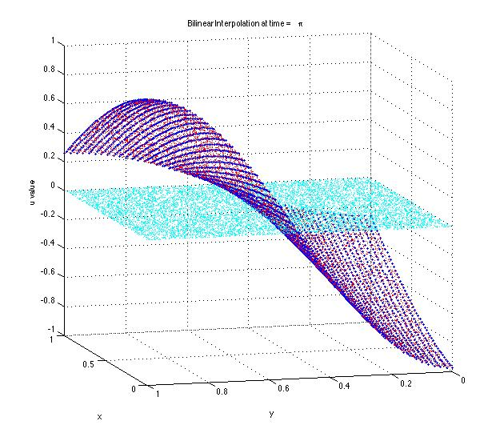
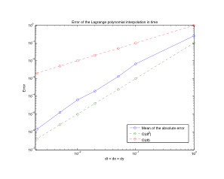
Validation: Interpolation
Spatial: we interpolate a surface at points for which we have the function values
Temporal: we interpolate the same surface but with a time dependence

Slide 7
Runge Kutta 4 (RK4)
Fixed time step, h
Next function value is determined by a weight of function values between x_{n} and x_{n+1}
All function evaluations require interpolation
4 time interpolations = 16 spatial interpolations

Slide 8
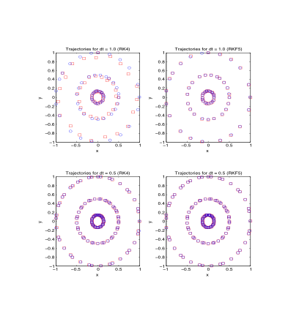
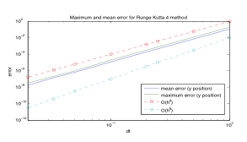
Validation: RK4
Red circles - numerical solution
Blue squares – true solution

Slide 9
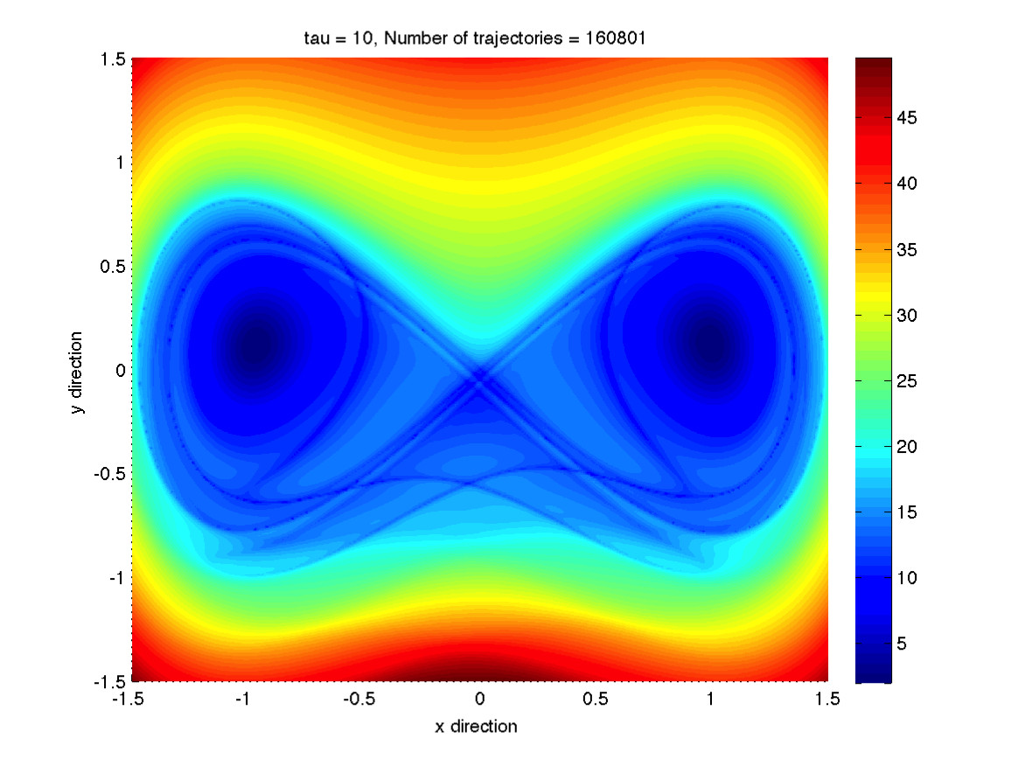
M Function
dM/dt is integrated along the path, just as
x(t) and y(t) are from –τ + t₀ to τ + t₀
This gives us the distance a particle travels
within 2τ
Regions where particles stay together should have homogeneous distance values. This method reveals those coherent structures as well as stable and unstable manifolds
We can then plot each initial point (x₀,y₀) with it’s corresponding M value being represented using a color scale

Slide 10
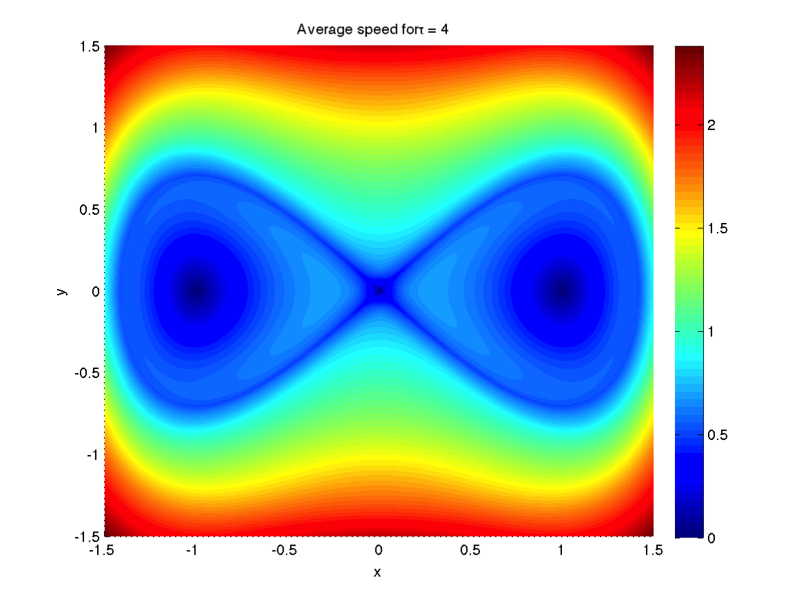
Validation: M Function
Circular trajectories and Duffing equation

Slide 11
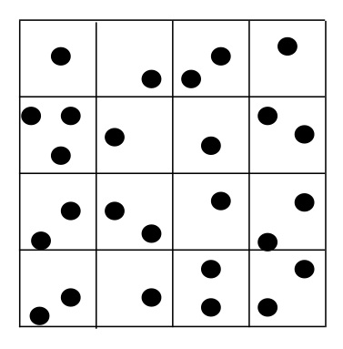
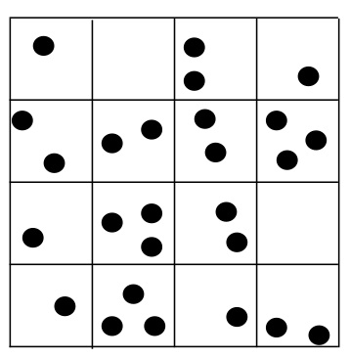
Probabilistic Method
D_{i} is the domain at t₀ , D_{j} is the domain at time t₀ ± τ (split into cells)
We define the transition matrix, T, such that the elements, T_{xy}, give us the probability that a point in cell x_{i} will end up in cell y_{j} [7].

Slide 12
Probabilistic Method
We find the left eigenvector associated with the largest eigenvalues to try and reconstruct the dominating dynamics
We find the eigenvalues and vectors using MATLAB’s eigs function
Then we reshape the eigenvector back into the original 2D domain

Slide 13
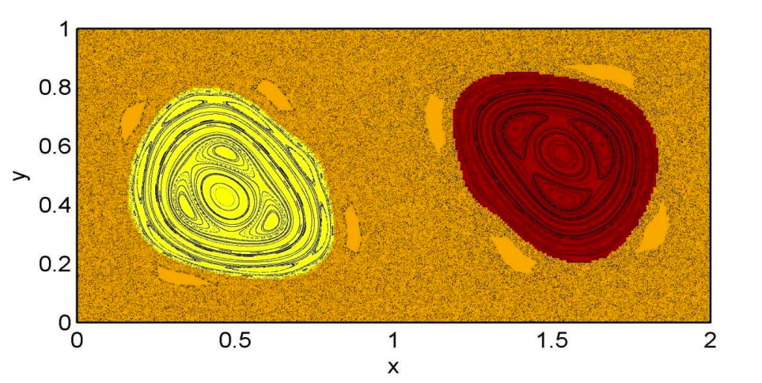
Validation: periodically driven double gyre flow
Period 1 orbits
Froyland and Padberg-Gehle (2014)

Slide 14
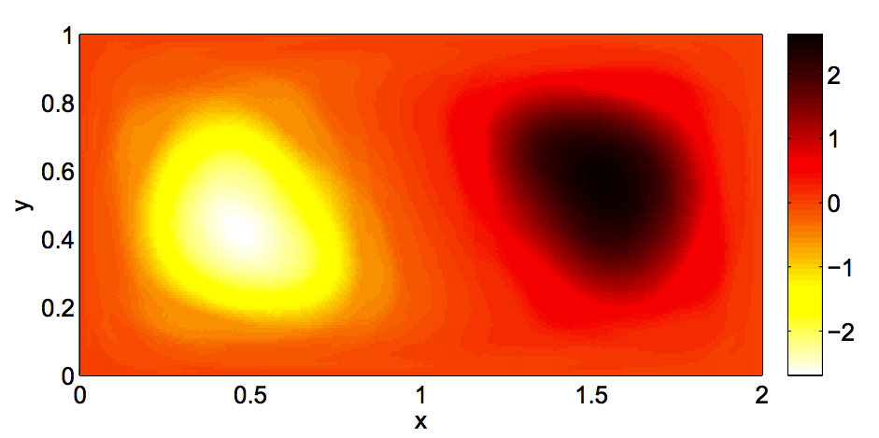
Validation: periodically driven double gyre flow
cell width of 2⁻⁷ on the domain
  13,107,200 trajectories
  t₀ = 0.0 and τ=1.0
λ₂ = 0.9997 λ₂ = 0.9998 in paper
Our results Results from [2]

Slide 15
Testing: Chesapeake Bay
Now that we have developed the analysis methods, we would like to test them on data from the Chesapeake Bay.

Slide 16
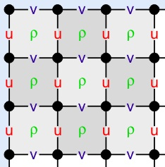
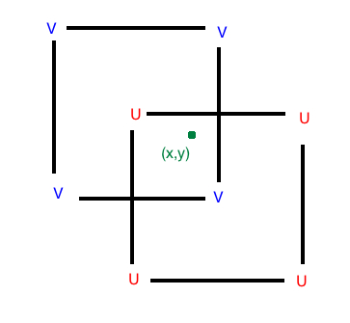
Application: Chesapeake Bay
Regional Ocean Modeling System (ROMS)
Terrain-following equations model
Velocities (u and v) are staggered using Arakawa C grid
ROMS wiki: Numerical Solution Technique. April 2012

Slide 17
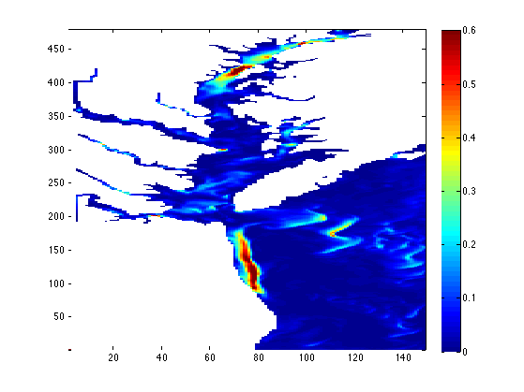
Kinetic energy values in ROMS
Blue corresponds to lower energy, red to higher energy
For short τ we expect to see higher M values where we see relatively higher energy.

Slide 18
Kinetic energy values in ROMS
Blue corresponds to lower energy, red to higher energy
For short τ we expect to see higher M values where we see relatively higher energy.

Slide 19
Validating the Chesapeake Bay M function
To validate:
  We apply our code to circular trajectories generated using velocities generated on an Arakawa-C grid
  Compare to trajectories obtained through ROMS
  For both, we look at the point-wise percent error given by
  Where M is our value of M at the point and M_{v} is the validation
  value of the point

Slide 20
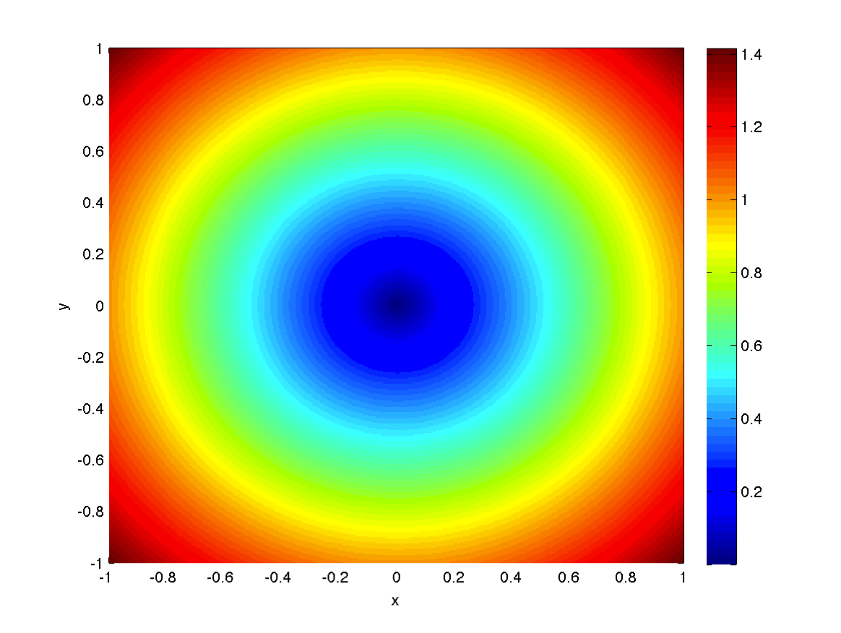
Validating the Chesapeake Bay M function
We apply our code to circular trajectories generated using velocities generated on an Arakawa-C grid
  Left: M function results for 160,801 trajectories (dt = .065)
  Right: Max point-wise percent error as a function of dt (slope = 4.3)

Slide 21
Validating the Chesapeake Bay M function
Mouth of Chesapeake Bay at hour 6
Forward integration shown (left) with point-wise percent error (right)
M values measured in meters

Slide 22
Chesapeake Bay: M function
Chesapeake bay for τ = 10 hours
Units: meters/second
72,581 Trajectories,
  181 by 401

Slide 23
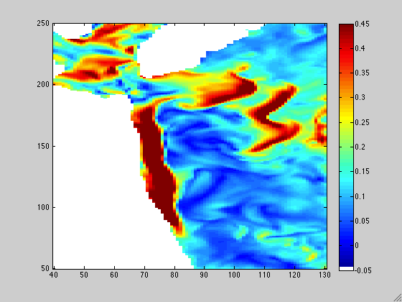
Forward Integration

Slide 24
Probabilistic Analysis
Analyze probabilities of a particle going from one cell at t = 0 to another cell at t = 6 hours
Rough analysis where we have 16 particles per cell, cell length is one grid length from M function

Slide 25
Probabilistic Analysis
λ is approximately equal to 1.0000
T for 194,848 trajectories from t = 0 to t = 6 hours
Eigenvector associated with the largest eigenvalue, v₁
We see repeat features in the next 6 eigenvectors

Slide 26
Probabilistic Analysis
v₁ compared to the forward portion of the M function analysis

Slide 27
Probabilistic Analysis
Next unique eigenvector, v₂

Slide 28
Probabilistic Analysis
Third unique eigenvector, v₃

Slide 29
Probabilistic Analysis
v₄ (left) and v₅ (right)

Slide 30
Deterministic versus Probabilistic Methods
Deterministic:
  Easier to detect dissipative regions
  Doesn’t require as many particles (for the same resolution)
Probabilistic:
  Easier to detect periodic and underlying features
  Only requires original and final positions
  Can show us connections between different features

Slide 31
Further research
Nonautonomous velocity field
    What happens when we take into account tides?
3D analysis
    What are the depth dependent features?
Time dependence of the eigenvectors
    How do the eigenvectors evolve over time?
    What is the dependence on τ?

Slide 32
Deliverables
Proposal document and presentation
Midyear document and presentation
Final document and presentation
Codes
ROMS data set

Slide 33
Schedule: Part 1
Stage 1: October – Late November
  Interpolation
    Bilinear without interpolating in time (October)
    Bicubic without interpolating in time (January)
    Spatial interpolation with 3rd order Lagrange polynomial interpolation in time (November)
    Time permitting: Optimizing interpolation and integration methods (with parallelization) (January)
Stage 2: Late November – December
    4th order Runge Kutta (November)
    5th order Runge Kutta Fehlberg (November-Early December)
    Time permitting: Adjustable time steps

Slide 34
Schedule: Part 2
Stage 3: January – mid February
  Lagrangian analysis using M - Function
Stage 4: Mid February – April
  Lagrangian analysis using probabilistic method
    Set up indexing (February)
    Solve the system D_{i} T = D_{j} (Early March)
    Get eigenvectors and eigenvalues of T (March)
Stage 5: Testing
  Test Deterministic and probabilistic methods on Chesapeake Bay database (April)

Slide 35
Acknowledgements
I would like to thank my advisor Kayo Ide as well as Bin Zhang who generated the ROMS validation data for this project

Slide 36
References
[1] Froyland G., Padberg-Gehle K. Ergodic Theory, Open Dynamics, and Coherent Structures., "Chapter: Almost-invariant and finite-time coherent sets: directionality, diration, and diffusion.” Mathematics and Statistics Vol. 70, Springer (2014)
[2] ROMS wiki: Numerical Solution Technique. April 2012. Last visited: Sept. 22 2013. https://www.myroms.org/wiki/index.php/Numerical_Solution_Technique
[3] Mancho A. M., Small D., Wiggins S. “A comparison of methods for interpolating chaotic flows from discrete velocity data”. Computers & Fluids, 35 (2006), 416-428.
[4] Xiao Shu. “Bicubic Interpolation” McMaster University, Canada. March 25th 2013. http://www.ece.mcmaster.ca/~xwu/3sk3/interpolation.pdf
[5] Greg Fasshauer. “Chapter 5: Error Control” Illinois Institute of Technology, Chicago, IL. April 24, 2007.
http://www.math.iit.edu/~fass/478578_Chapter_5.pdf
[6] Mancho A. M., Mendoza C. “Hidden Geometry of Ocean Flows”. Physical Review Letters 105(3) (2010).
[7] Froyland G., et al. “Coherent sets for nonautonomous dynamical systems”. Physica D 239 (2010) 1527 – 1541.

Slide 37
References
[8] Alligood, K. T., Sauer T. D., and Yorke J. A. Chaos. Springer New York, 1996. (pp 406-407)
[9] Lenci S., Rega G., “Global optimal control and system-dependent solutions in the hardening Helmholtz–Duffing oscillator” Chaos, Solitons & Fractals, 21(5), (2004) 1031-1046, http://dx.doi.org/10.1016/S0960-0779(03)00387-4.
[10]Hoffman, M. J., T. Miyoshi, T. W. N. Haine, K. Ide, C. W. Brown, and R. Murtugudde, 2012: An Advanced Data Assimilation System for the Chesapeake Bay: Performance Evaluation. J. Atmos. Ocean. Tech., 29, 1542-1557. doi:DOI:10.1175/JTECH-D-11-00126.1.
[11] Mancho A. M., Wiggins S., Curbelo J., Mendoza C. “Lagrangian Descriptors: A Method for Revealing Phase Space Structures of General Time Dependent Dynamical Systems”. Communications in Nonlinear Science and Numerical Stimulation, 18(12) (2013), 3530-3557.
[12] Dinga J., Li T. Y., Zhou A. “Finite approximations of Markov operators”. Journal of Computational and Applied Mathematics 147 (2002) 137 – 152.
[13] Stremler M. A. et al. “Topological Chaos and Periodic Braiding of Almost-Cyclic Sets”. Physical Review Letters, 106 (11) (2011).

Slide 38
Chesapeake Bay: total M function
Left: 3 hours
Right: 10 hours

Slide 39
Supplementary Material
Difference in color scaling in v₄

Slide 40
Supplementary Material
Difference in color scaling in v₅

