Slide 1
Analysis of Lagrangian Coherent Structures of the Chesapeake Bay
Stephanie Young, syoung3@math.umd.edu
Kayo Ide, Ide@umd.edu
Atmospheric and Oceanic Science Department
Center for Scientific Computing and Mathematical Modeling
Applied Mathematics, Statistics and Scientific Computing Program
Earth System Science Interdisciplinary Center
Institute for Physical Science and Technology

Slide 2
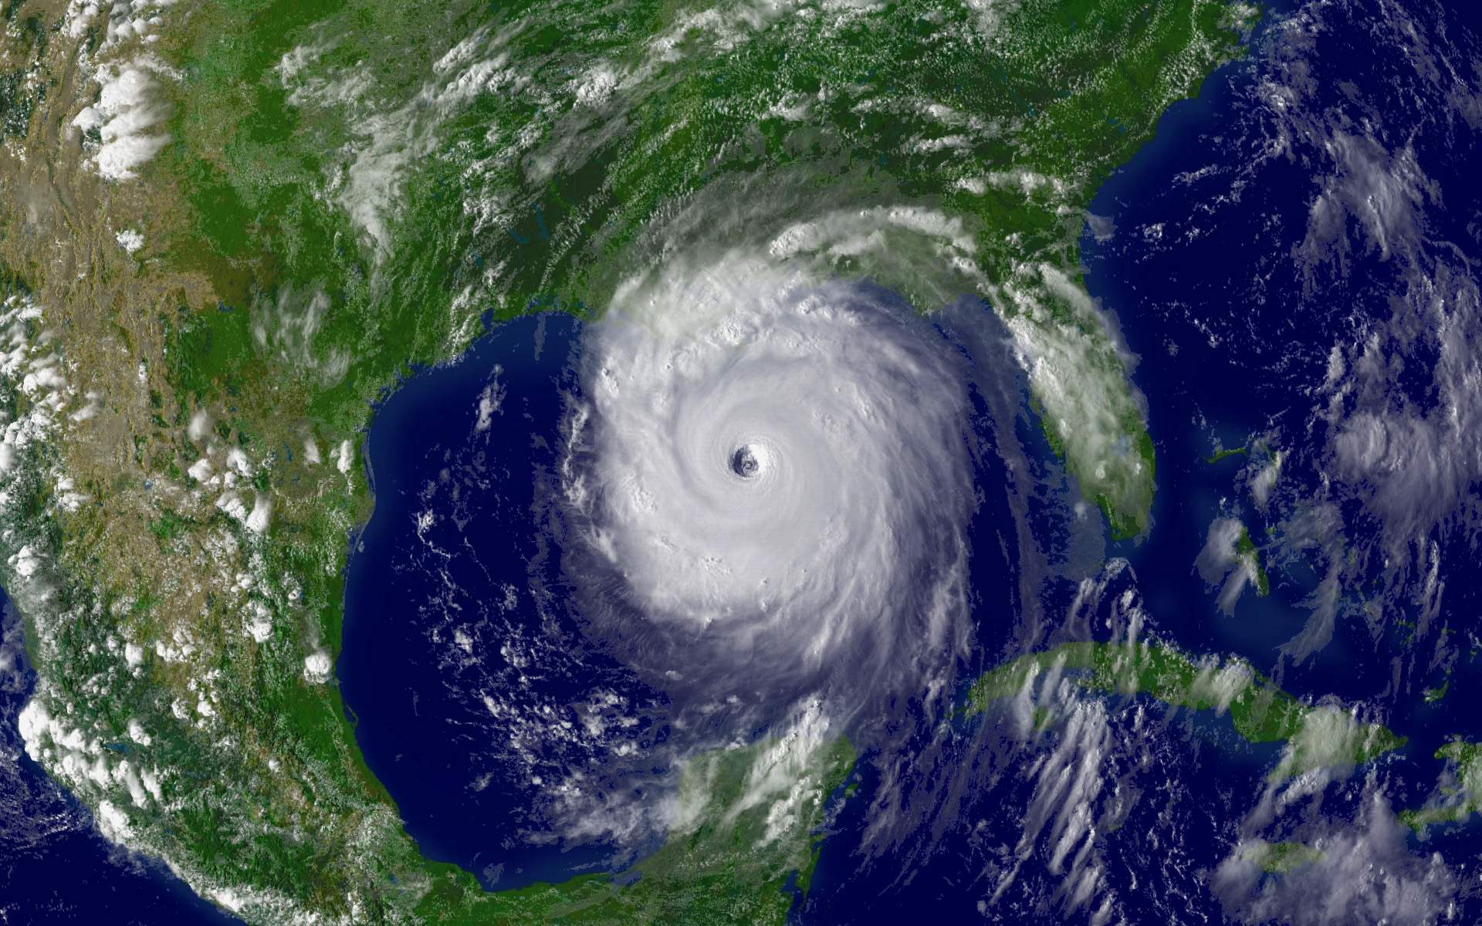
Problem
We would like to be able to analyze the dynamics of the Chesapeake bay using a discrete data set
Coherent structures:
Structures that separate dynamically different sets of particles [1]
We want to identify these structures
Examples of Coherent Structures:
Hurricanes
Jet Streams
http://www.katrina.noaa.gov/images/katrina-08-28-2005.jpg

Slide 3
Lagrangian Dynamics
Eulerian vs. Lagrangian
Eulerian: interested in behavior at a fixed point in space
Doesn’t tell us about how particles move together
Lagrangian: interested in behavior of a particle as it follows some trajectory
Our question: What happens to particles with different initial conditions?

Slide 4
Lagrangian Dynamics
We would like to be able to compute the trajectory numerically (integrating the velocity field)
u and v are given on the grid points but when we integrate, the trajectories are not confined to the grid

Slide 5
Lagrangian Dynamics
Part 1: Basic Set up
Writing code to interpolate the discrete velocity field
Calculating trajectories for given set of initial conditions
Part 2: Lagrangian Analysis
Qualitative approach
Probabilistic approach

Slide 6
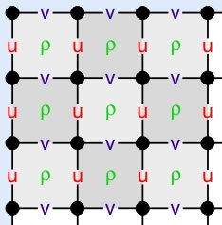
Interpolation
Given some discrete velocity field data set we would like to be able to determine the velocity of any point in our domain.
Our data: staggered variables using Arakawa C-grid [2]
East-west velocities (u) are evaluated
on right and left faces of grid
North-south velocities (v) are evaluated
on the upper and lower faces of the grid
We need to interpolate this data
https://www.myroms.org/wiki/index.php/Numerical_Solution_Technique#Horizontal_Discretization

Slide 7
Interpolation Method
We will be using a Bicubic Spatial interpolation method, combined with a 3rd order Lagrange polynomial in time [3]
Interpolate u and v separately
Bicubic – cubic interpolation in 2D [4]
Uses function and first derivative values
Will need to approximate derivatives with a central differences method

Slide 8
Interpolation Method
Also use bilinear interpolation (fit with linear functions)
Lagrange Polynomials for some using points t_{i-1}, t_{i}, t_{i+1}, t_{i+2}
I will compare the interpolation process with and without the use of parallel processing

Slide 9
Trajectories
Given a set of initial particle positions, what are the particle trajectories after some time?
Once the interpolation is complete, I will integrate the velocity field over some time to get the trajectories
Methods (both fixed time step) [5]:
Forth order Runge Kutta (for comparison)
Fifth order Runge Kutta Fehlberg

Slide 10
Lagrangian Analysis: the M Function
For our analysis, we have n = 2 so the M function is [6]
which is simply the distance traveled by a particle
with initial condition at time t₀

Slide 11
M Function (Cont.)
What we are calculating is the distance traveled by a particle in some time 2τ
We can then plot each initial point (x₀,y₀) with it’s corresponding M value being represented using a color scale

Slide 12
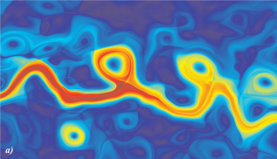
M Function
M Function Applied to the Kuroshio current (May 2 2003)
τ= 15
Contrast between blue and red: unstable manifold
Blue region in center, eddy, short path distance
Red, fast moving particles in the current
Mancho A. M., Mendoza C. “Hidden Geometry of Ocean Flows”. Physical Review Letters 105(3) (2010).

Slide 13
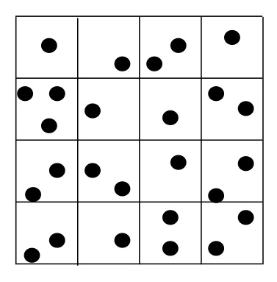
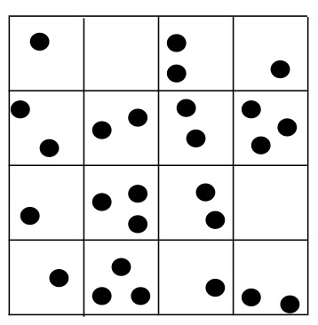
Probabilistic Lagrangian Analysis
We have points on a domain, split it up into cells
Each cell has 100 points, evenly distributed
Turn 2D grid into a 1D vector
values are the number of points in that grid space

Slide 14
Probabilistic Lagrangian Analysis
Want to solve for some transition matrix with elements T_{xy} that gives us the probability that a point in cell x_{i} will end up in cell y_{j} [7]
Compute SVD of T matrix
Largest eigenvalues (with corresponding eigenvectors) can help reconstruct dominating dynamics

Slide 15
Implementation
2.3 GHz Intel Core i5 Processor
Matlab
Parallel Processing for the Interpolation and Trajectories

Slide 16
Regional Ocean Modeling System (ROMS)
“ROMS is a free-surface, terrain-following, primitive equations ocean model widely used by the scientific community for a diverse range of applications” [2]
We will use the system to generate simulated data of the Chesapeake bay, on which I will perform my analysis
Courtesy of the UMD ROMS group

Slide 17
Validation
Interpolation:
Run code on some analytically known function [3]
Trajectories:
Can test code against well known solvers, such as ODE45
Can compare to trajectories calculated using ROMS

Slide 18
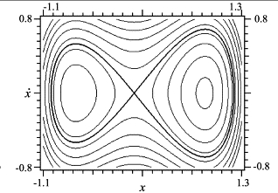
Lagrangian Analysis Validation
Apply both methods to well studied systems with unstable/stable manifolds
Example: The undamped Duffing equation [8],[9]
Compare methods to one another
http://dx.doi.org/10.1016/S0960-0779(03)00387-4

Slide 19
Schedule: Part 1
Stage 1: October – Late November
Interpolation
Bilinear without interpolating in time (October)
Bicubic without interpolating in time (October)
Bicubic with 3rd order Lagrange polynomial interpolation in time (November)
Time permitting: Parallelize the interpolation process
Stage 2: Late November – December
4th order Runge Kutta (November)
5th order Runge Kutta Fehlberg (November-Early December)
Time permitting: Adjustable time steps

Slide 20
Schedule: Part 2
Stage 3: January – mid February
Lagrangian analysis using M - Function
Stage 4: Mid February – April
Lagrangian analysis using probabilistic method
Set up indexing (February)
Solve the system D_{i} T_{ij} = D_{j} (Early March)
SVD of T_{ij}: Get eigenvectors and eigenvalues (March)
Time permitting: Create my own SVD code (April)

Slide 21
Deliverables
Code for interpolating ROMS data and calculating trajectories for the set of initial conditions
Code for the M-Function analysis
Code that calculates the transition matrix, its eigenvectors and eigenvalues
Comparison of M-Function and Transition matrix methods
ROMS data set

Slide 22
References
[1] Shadden, S. C., Lekien F., Marsden J. E. "Definition and properties of
Lagrangian coherent structures from finite-time Lyapunov exponents in two-
dimensional aperiodic flows". Physica D: Nonlinear Phenomena 212, (2005)
(3–4), 271–304
[2] ROMS wiki: Numerical Solution Technique. April 2012. Last visited: Sept.
22 2013. <https://www.myroms.org/wiki/index.php/
Numerical_Solution_Technique>
[3] Mancho A. M., Small D., Wiggins S. “A comparison of methods for
interpolating chaotic flows from discrete velocity data”. Computers &
Fluids, 35 (2006), 416-428.
[4] Xiao Shu. “Bicubic Interpolation” McMaster University, Canada. March
25th 2013. http://www.ece.mcmaster.ca/~xwu/3sk3/interpolation.pdf
[5] Greg Fasshauer. “Chapter 5: Error Control” Illinois Institute of Technology,
Chicago, IL. April 24, 2007.
http://www.math.iit.edu/~fass/478578_Chapter_5.pdf

Slide 23
References
[6] Mancho A. M., Mendoza C. “Hidden Geometry of Ocean Flows”. Physical
Review Letters 105(3) (2010).
[7] Froyland G., et al. “Coherent sets for nonautonomous dynamical systems”.
Physica D 239 (2010) 1527 – 1541.
[8] Alligood, K. T., Sauer T. D., and Yorke J. A. Chaos. Springer New York, 1996.
(pp 406-407)
[9] Lenci S., Rega G., “Global optimal control and system-dependent solutions in the
hardening Helmholtz–Duffing oscillator” Chaos, Solitons & Fractals, 21(5), (2004)
1031-1046, http://dx.doi.org/10.1016/S0960-0779(03)00387-4.

