Slide 1
Analysis of Lagrangian Coherent Structures of the Chesapeake Bay: Mid-year Report
Stephanie Young, syoung3@math.umd.edu
Kayo Ide, Ide@umd.edu
Atmospheric and Oceanic Science Department
Center for Scientific Computing and Mathematical Modeling
Applied Mathematics, Statistics and Scientific Computing Program
Earth System Science Interdisciplinary Center
Institute for Physical Science and Technology

Slide 2
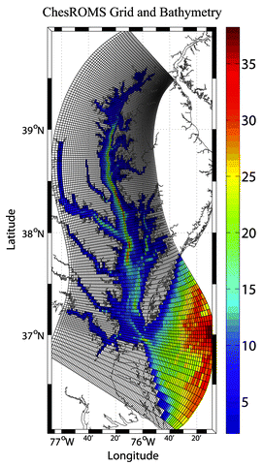
Problem
We would like to be able to analyze the dynamics of the Chesapeake bay using a discrete data set
Would like to be able to detect coherent structures in the Bay
[11] Hoffman, M. J. et al “An Advanced Data Assimilation System for the Chesapeake Bay: Performance Evaluation”

Slide 3
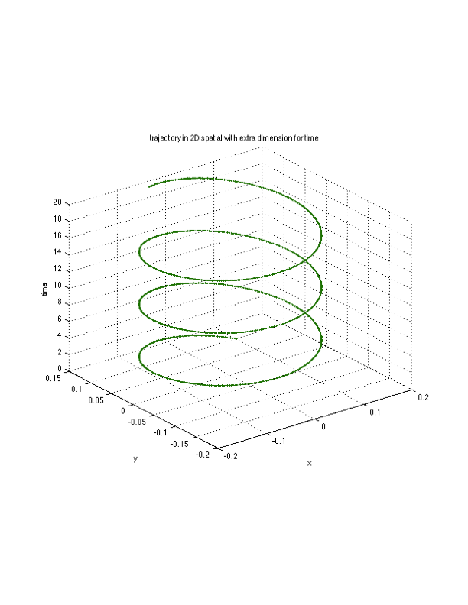
Where do we start?
Calculate trajectories of many particles using discrete velocity data
But what if the (x,y) coordinate doesn’t fall on the grid?
What if we want a velocity value at a time at which we don’t have data?

Slide 4
Spatial Interpolation
What if the (x,y) coordinate doesn’t fall on a data point?
Interpolate using data at the surrounding 4 points
  Bilinear Interpolation (requires velocity at the 4 surrounding points)
  Bicubic Interpolation (for future comparison)

Slide 5
Bilinear Interpolation
We interpolate each velocity u(x,y) using the 4 nearest neighbors by fitting the surface below (with the 4 function values)
Solve for a₀, a₁, a₂ and a₃ and then plug (x,y) coordinate into above equation

Slide 6
Time interpolation
What if we want a velocity value at a time at which we don’t have data?
Use a 3rd order polynomial to interpolate in time (requires 4 spatial interpolations)

Slide 7
Trajectories
Given a set of initial particle positions, what are the particle trajectories after some time?
Once the interpolation is complete we perform time integration to obtain trajectories
Methods [5,6] :
  Forth order Runge Kutta (fixed time steps)
  Fifth order Runge Kutta Fehlberg (Time adaptive)

Slide 8
Runge Kutta 4 (RK4)
Fixed time step, h
Next function value is determined by a weight of function values between x_{n} and x_{n+1}
All function evaluations require interpolation
4 time interpolations = 16 spatial interpolations

Slide 9
Runge Kutta Fehlberg 5 (RKF)
Produces both 4th order and a 5th order solution
Scheme can be determined through Butcher tableau or a Taylor Table

Slide 10
Runge Kutta Fehlberg 5 (RKF)
Reason for RKF:
  Time adaptive
  Only 6 function evaluations (instead of 9)
  Each function evaluation is an interpolation (expensive)
  6 time interpolations = 24 spatial interpolations
  End up with a 5th order solution
Given the difference between the 4th order and 5th order schemes, , and the error tolerance, _{max} :

Slide 11
Validation
Interpolation:
  Run code on some analytically known function [3]
  A = 0.1 , k = 1, ε= 10, ω=0.6 for our interpolation
Trajectories:
  Validated on known linear ODEs

Slide 12
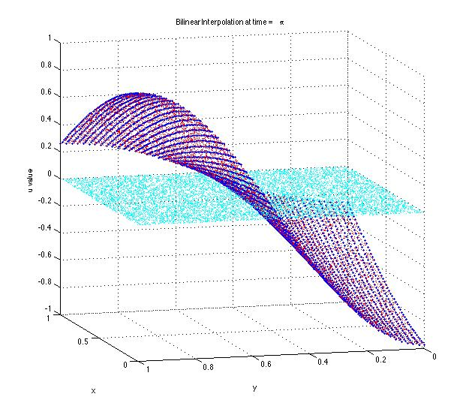
Bilinear: Validation and Testing
Blue dots are the uniformly distributed data points
Red dots are the interpolated values
Cyan is the difference between the true and interpolated values (error)
dx = dy = .02
t = 1.0
10,000 random (x,y) pairs

Slide 13
2nd order approximation of the surface
10 to 500 random (x,y) pairs per dx (larger dx requires more pairs)
For small dx, less variation
dx and dy both changed (together)

Slide 14
Lagrange Polynomial: Validation and Testing
Mean and Maximum error result in same slope (max not shown) (average of 10 random (x,y,t) values)
dx, dy also changed (same change as dt)
O(dt²) (or we could say O(dx²) )
Mean error shown (Maximum error has the same slope) (average of 20 random (x,y,t) values)
dx and dy are held constant, only dt changes
Error is independent of dt, order of accuracy depends on the accuracy of the spatial interpolation method

Slide 15
RK4 and RKF5: Validation and Testing
Red circles - numerical solution
Blue squares – true solution
Integrated from t = 0 to t = 20
For the “data” or grid on which we interpolate:
dx = dy = 0.1 and dt_{grid} = 0.5
Initial conditions: (0.1,0.1) , (0.5,0) and (0,1.0)

Slide 16
Runge Kutta 4 and Runge Kutta Fehlberg error: time step dependence
The grid parameters are the same as the trajectories given on the previous slide
In the plots, h = dt
Each error calculation involved calculating 20 trajectories (for both methods)
dt is constant for both methods (RKF5 did not use time adaptive time steps)
Error in the x and y positions were of the same order (error in x position not shown)
RK4 is O(h⁴)
RKF5 is O(h⁵)

Slide 17
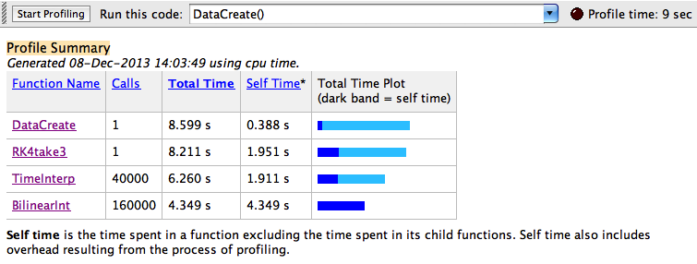

Where did the time go?
50 trajectories, dt = .2, grid parameters same as trajectories on previous 2 slides
Both methods spend approximately 75% of the time interpolating
For RKF5: 6 time interpolations instead of 9 for each integration step
For RKF5, this means we saved 4.5 seconds (~9s instead of 13.5s for interpolation)

Slide 18
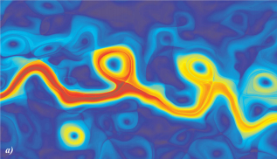
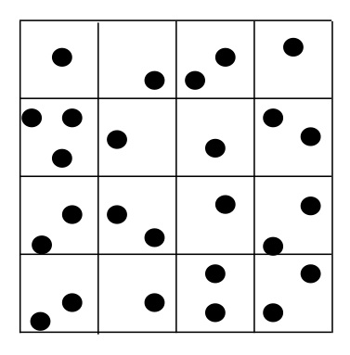
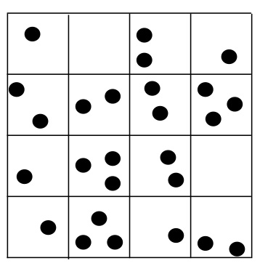
Next semester: Lagrangian Analysis
Deterministic Approach
Probabilistic Approach
Mancho A. M., Mendoza C. “Hidden Geometry of Ocean Flows”. Physical Review Letters 105(3) (2010).

Slide 19
Schedule: Part 1
Stage 1: October – Late November
  Interpolation
    Bilinear without interpolating in time (October)
    Bicubic without interpolating in time (January)
    Spatial interpolation with 3rd order Lagrange polynomial interpolation in time (November)
    Time permitting: Optimizing interpolation and integration methods (with parallelization) (January)
Stage 2: Late November – December
    4th order Runge Kutta (November)
    5th order Runge Kutta Fehlberg (November-Early December)
    Time permitting: Adjustable time steps

Slide 20
Schedule: Part 2
Stage 3: January – mid February
  Lagrangian analysis using M - Function
Stage 4: Mid February – April
  Lagrangian analysis using probabilistic method
    Set up indexing (February)
    Solve the system D_{i} T_{ij} = D_{j} (Early March)
    SVD of T_{ij}: Get eigenvectors and eigenvalues (March)
    Time permitting: Create my own SVD code (April)

Slide 21
References
[1] Shadden, S. C., Lekien F., Marsden J. E. "Definition and properties of
Lagrangian coherent structures from finite-time Lyapunov exponents in two-
dimensional aperiodic flows". Physica D: Nonlinear Phenomena 212, (2005)
(3–4), 271–304
[2] ROMS wiki: Numerical Solution Technique. April 2012. Last visited: Sept.
22 2013. <https://www.myroms.org/wiki/index.php/
Numerical_Solution_Technique>
[3] Mancho A. M., Small D., Wiggins S. “A comparison of methods for
interpolating chaotic flows from discrete velocity data”. Computers &
Fluids, 35 (2006), 416-428.
[4] Xiao Shu. “Bicubic Interpolation” McMaster University, Canada. March
25th 2013. http://www.ece.mcmaster.ca/~xwu/3sk3/interpolation.pdf
[5] Greg Fasshauer. “Chapter 5: Error Control” Illinois Institute of Technology,
Chicago, IL. April 24, 2007.
http://www.math.iit.edu/~fass/478578_Chapter_5.pdf
[6] Mathews, J. H. Numerical Methods Using Matlab, 4th Edition. Prentice-Hall Inc.,
New Jersey, 2004. Sec. 9.5: Runge-Kutta Methods.

Slide 22
References
[7] Mancho A. M., Mendoza C. “Hidden Geometry of Ocean Flows”. Physical
Review Letters 105(3) (2010).
[8] Froyland G., et al. “Coherent sets for nonautonomous dynamical systems”.
Physica D 239 (2010) 1527 – 1541.
[9] Alligood, K. T., Sauer T. D., and Yorke J. A. Chaos. Springer New York, 1996.
(pp 406-407)
[10] Lenci S., Rega G., “Global optimal control and system-dependent solutions in the
hardening Helmholtz–Duffing oscillator” Chaos, Solitons & Fractals, 21(5), (2004)
1031-1046, http://dx.doi.org/10.1016/S0960-0779(03)00387-4.
[11]Hoffman, M. J., T. Miyoshi, T. W. N. Haine, K. Ide, C. W. Brown, and R.
Murtugudde, 2012: An Advanced Data Assimilation System for the Chesapeake
Bay: Performance Evaluation. J. Atmos. Ocean. Tech., 29, 1542-1557. doi:DOI:
10.1175/JTECH-D-11-00126.1.

