Slide 1
Classification of Hand-Written Digits Using Scattering Convolutional Network
Dongmian Zou
Advisor: Professor Radu Balan

Slide 2
Background

Slide 3
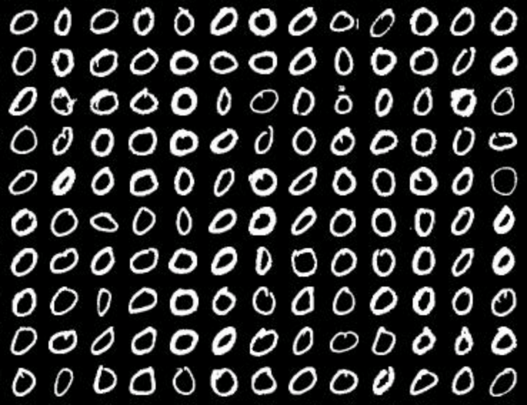
Overview
Image classification
Hand-written digits
Feature extractor
Convolutional neural network
Machine learning techniques
Part of MNIST training data retrieved from
http://www.cs.nyu.edu/~roweis/data.html

Slide 4
Convolutional Network (ConvNet)
Multi-layer structure
Different layers extract different features (edges, contours, parts, etc.)
Input
layer
Hidden
layer
Hidden
layer
Hidden
layer
Output
layer

Slide 5
Convolutional Network (ConvNet)
Convolution
Each convolution layer contains three stages
Convolution stage
Detector stage
Pooling stage
convolution
with filters
nonlinearity
applied
local max
or averaging

Slide 6
Scattering Convolutional Network
Convolution stage
Detector stage
Pooling stage
dilation of
wavelets
low-pass
filter

Slide 7
Scattering Convolutional Network
Scattering propagator
Scattering transform
Input
Output

Slide 8
Scattering Convolutional Network
S. Mallat proved that the scattering network is a good representation for image classification
invariant to translation (approximately)
stable to small-scale deformation
Mallat’s theory requires a strict condition on the wavelet
T. Wiatowski and H. Bölcskei give a relaxed condition
See below for reference
S. Mallat, Group Invariant Scattering.
T. Wiatowski and H. Bölcskei, Deep Convolutional Neural Networks Based on Semi-Discrete Frames.

Slide 9
Machine Learning Techniques
Gradient descent
find the minimum of a loss function
iterative method

Slide 10
Machine Learning Techniques
Error back-propagation
based on the chain rule of taking derivatives

Slide 11
Machine Learning Techniques
Support vector machine (SVM)
two-class classification problem {+1, -1}
determined by the sign of

Slide 12
Approach

Slide 13
Network Structure
Scattering network
One input layer
Two convolution layer
One output layer
SVM

Slide 14
images of 28-by-28 pixels
SVM
classification result determined
by the sign of

Slide 15
The Optimization Problem
Our optimization problem for training the model is
where
hinge-loss
and
is the grouping of the following
where
fixed wavelet

Slide 16
images of 28-by-28 pixels
Input:
pairs of
0
labels (which class x belongs to)
Unknown parameters:
SVM
L is down-sampling factor
g is the low-pass filter
use cross validation for both

Slide 17
Two step optimization
The above problem is non-convex
difficult to solve with respect to {λ, w, b}
We can iterate between two problems
First, fix w and b, train the filters in the scattering network
Second, fix the filters in the scattering network, train the SVM
We use libSVM library to train the SVM
Publicly available at https://www.csie.ntu.edu.tw/~cjlin/libsvm/
easier
convex

Slide 18
Convolution layer
Filters to train:
Each filter contains two parameters
Gradient descent
starting value: randomly generated; distant parameters in the same layer
learning rate: may change with step
back propagation

Slide 19
Project Details

Slide 20
Implementation
Personal Laptop
CPU: 2GHz Intel Core i7
Memory: 8 GB 1600 MHz DDR3
OS X El Capitan Version 10.11
MATLAB R2015b

Slide 21
Database
MNIST database
Publicly available at http://yann.lecun.com/exdb/mnist/
Image: 28×28 pixels (each pixels value between 0~255)
60,000 training examples
10,000 testing examples

Slide 22
Validation and Testing
Validation
Cross-validation
MatConvNet toolbox
publicly available at http://www.vlfeat.org/matconvnet/
Testing
Testing examples in MNIST database
Measure: percentage of errors
Compare with libSVM results

Slide 23
Timeline
2015
Sept - Oct: define the project, design the algorithm
Nov: write codes for network training
Dec: write codes for 2-class classification
Jan - Feb: complete validation
Mar: complete testing
Apr: wrap up the project
Multi-class if time permits
2016

Slide 24
Deliverables
Datasets
Toolboxes
MATLAB codes
Trained network
Results
Proposal, Reports, Presentation slides, etc.

Slide 25
Bibliography
[1] Y. Bengio, I. J. Goodfellow and A. Courville, Deep Learning, Book in preparation for MIT press, 2015.
[2] C. M. Bishop, Pattern Recognition and Machine Learning, New York: Springer, 2006.
[3] J. Bruna and S. Mallat, Invariant Scattering Convolution Networks, Pattern Analysis and Machine Intelligence, IEEE Transactions 35(8)(2013), 1872-1886.
[4] S. Mallat, Group Invariant Scattering, Comm. Pure Appl. Math., 65 (2012): 1331-1398.
[5] A. Krizhevsky, I. Sutskever, G. E. Hinton, ImageNet Classification with Deep Convolutional Neural Networks, Advances in Neural Information Processing Systems 2 (2012): 1097-1105.
[6] C. Szegedy et al, Going Deeper with Convolutions, Open Access Version available at http://www.cv-foundation.org/openaccess/content_cvpr_2015/papers/Szegedy_Going_Deeper_With_2015_CVPR_paper.pdf
[7] A. Vedaldi and K. Lenc, MatConvNet - Convolutional Neural Networks for MATLAB, Proc. of the ACM Int. Conf. on Multimedia, 2015.
[8] T. Wiatowski and H. Bölcskei, Deep Convolutional Neural Networks Based on Semi-Discrete Frames, Proc. of IEEE International Symposium on Information Theory (ISIT), Hong Kong, China, pp. 1212-1216, June 2015.

Slide 26
THANK YOU

